Slide 1



WELCOME
Participants

Slide 2
Sampling Techniques in Quantitative Research
Objective:
To have an understanding on the various types of sampling and appreciate its importance to ensure that the sample group is a true representative of the population as a whole in a quantitative study.

Slide 3
Sampling Techniques
Sampling is a process of selecting units (sample) from a population of interest so that by studying the sample the researcher may fairly generalize the results back to the population from which they were chosen.
When you conduct research about a group of people, it’s rarely possible to collect data from every person in that group. Instead, you select a sample.
The sample is the group of individuals who will actually participate in the research.

Slide 4
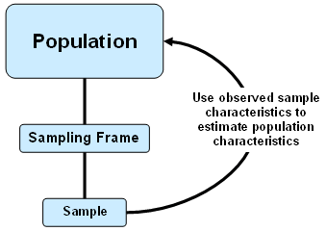
Sampling Frame
is a group of individuals (or a group of organizations) with some common defining characteristic that the researcher can identify and study. Withing this target population, researchers then select a sample for study (Yazon et al., 2019)
When developing a research study it is important to identify you population of interest such as: people, organizations, or group.
Prior to selecting a sample you need to define a sampling frame, which is a list of all the units of the population of interest.
Qualities of a good sampling frame:
  include all individuals in the target population.
  exclude all individuals not in the target population.
  includes accurate information that can be ised to contact selected individuals.

Slide 5
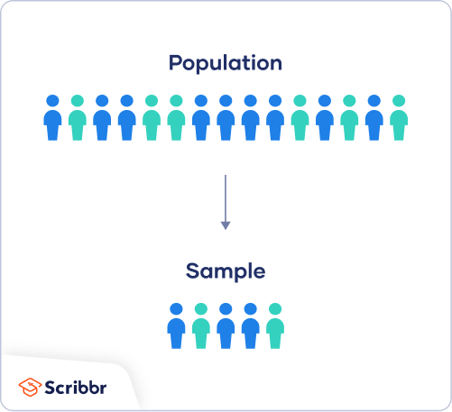
Understanding
Population vs. Sample
Population
Sample
  The entire group that you want to draw conclusion about.
  it is a goup of individuals who have the same characteristic. Ex: all teachers would make up the population, all secondary school heads in a school division etc.
  the specific group of individuals that you will collect data from.
Representative refers to the selection of individuals from sample of population such that the individuals selected are typical of the population under the study, enabling you to draw conclusions from the sample about the population as a whole.

Slide 6
Sample Size
The number of individuals you should include in your sample depends on various factors, including the size and variability of the population and your research design. There are different sample size calculators and formulas depending on what you want to achieve with statistical analysis.
A general rule of thumb: Select as large a sample as possible from the population. The larger the sample, the less the potential errir is that the sample will ne different from the population.
Sampling Error
The larger the sample, the less potential error difference between the sample estimate and the true population score, usually of 5%.

Slide 7
Confidence Level, Margin of Errors
Sample Size Formulas
provide the means for calculating the size of your sample based on several factors, such as confidence in the statistical test and sampling error.
  The first thing to understand in calculating the sample size is the difference between confidence levels and margins of error.
Confidence Level - Margins of Error
  Indicate the reliability of statistics that have been calculated by research
  Most research studies have confidence intervals of 90% confident, 95% confident, or 99% confident.
Standard Survey:
Confidence level of 95%
Margin of Error 5%

Slide 8
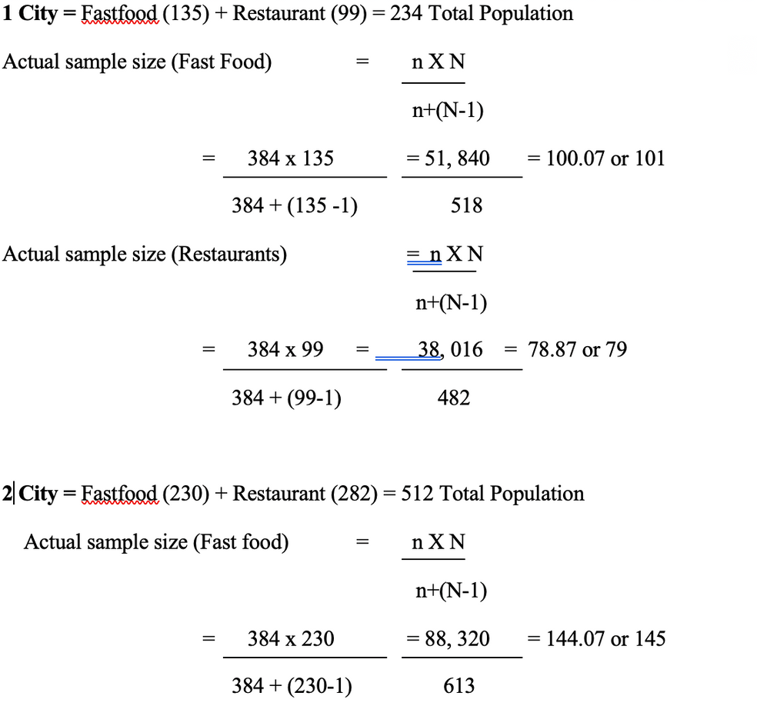
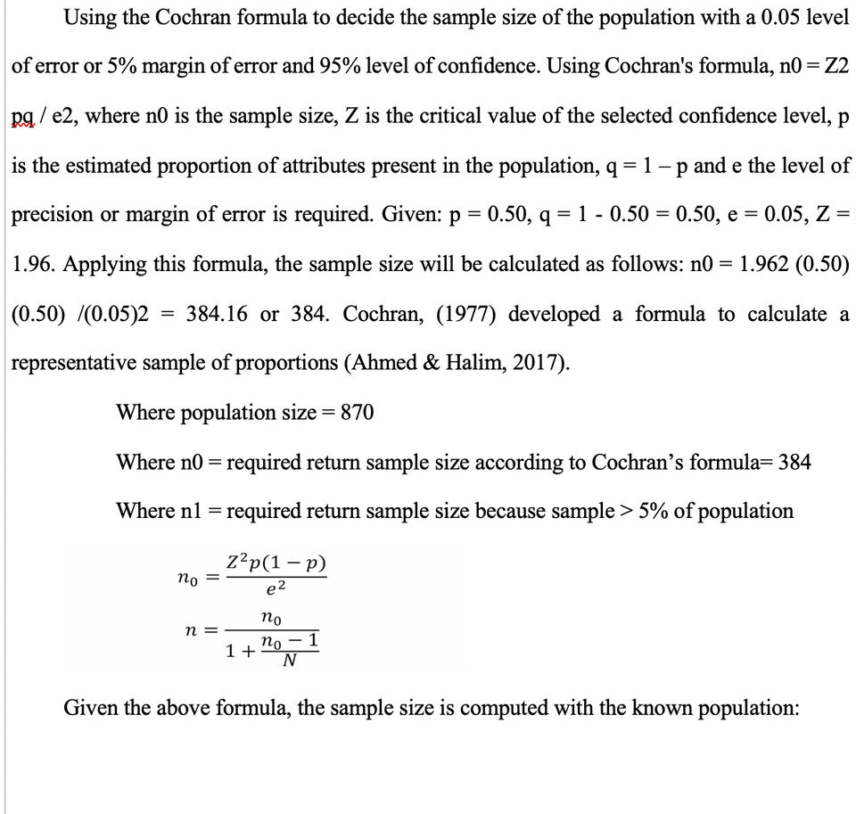
Confidence Level, Margin of Errors
Sample Size Formulas

Slide 9
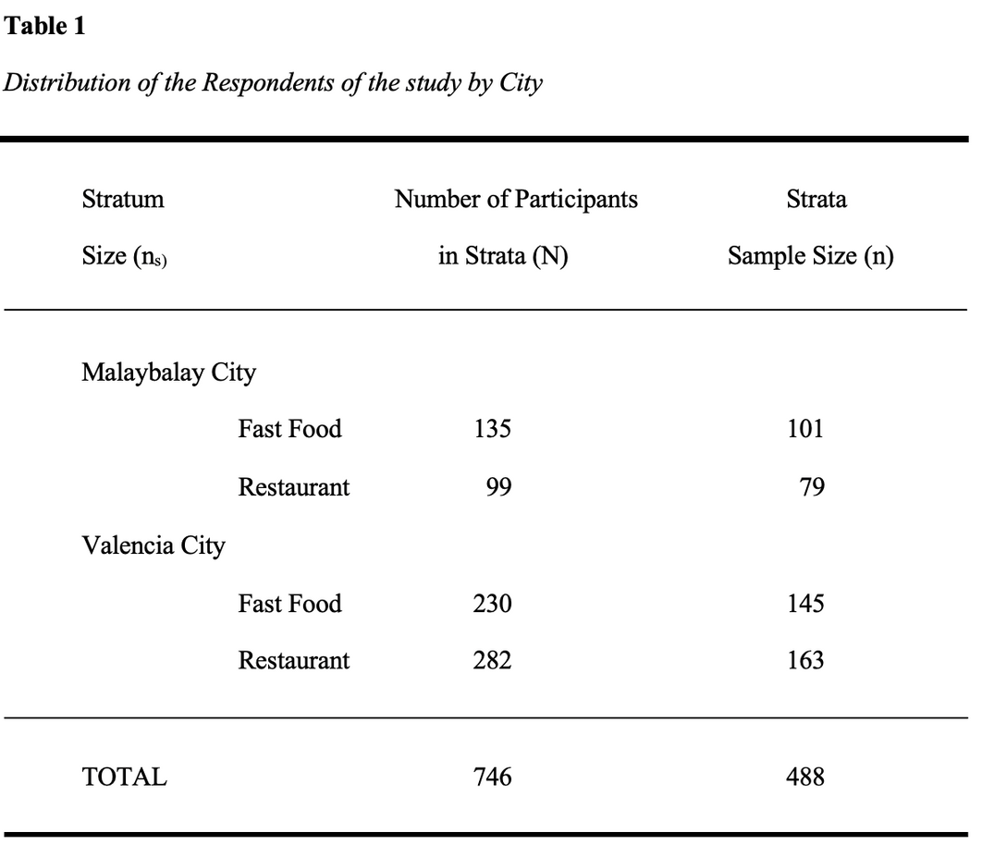

Confidence Level, Margin of Errors
Sample Size Formulas
1

Slide 10
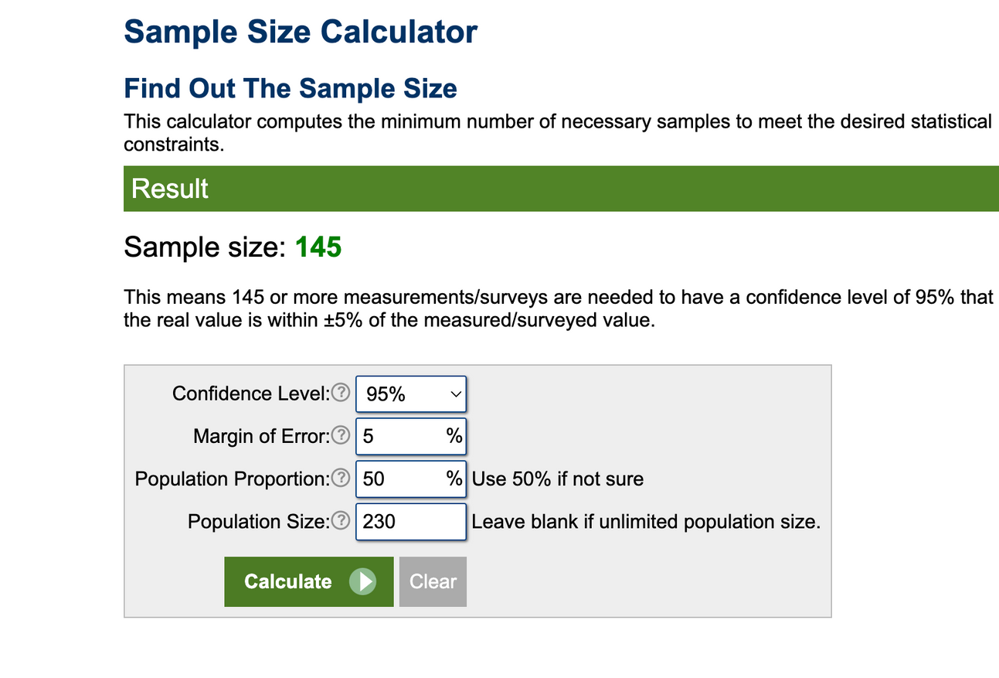

Sample Size Formulas
Standard Survey:
Confidence level of 95%
Margin of Error 5%
Our confidence level states that:
19 out of 20 times we conduct this survey our results would land within our margin of error of 5%.
Our 5% margin of error says that if we surveyed all 400+ respondents, the results could differ with a score of 5% or plus 5%, from its original score.
Respondents have rated their satisfaction on a scale from 1-10 and it resulted in a final average score of 7.8.
95% certainty that if we surveyed all 300 teachers our average score would be between 7.3 - 8.3.

Slide 11
Sampling Techniques
To draw valid conclusions from your results, you have to carefully decide how you will select a sample that is representative of the group as a whole. This is called a sampling method.
There are two primary types of sampling methods that you can use in your research:
Probability or Random
Non-Probability or Non-random
  involves random selection, allowing you to make strong statistical inferences about the whole group.
  involves non-random selection based on convenience or other criteria, allowing you to easily collect data.

Slide 12

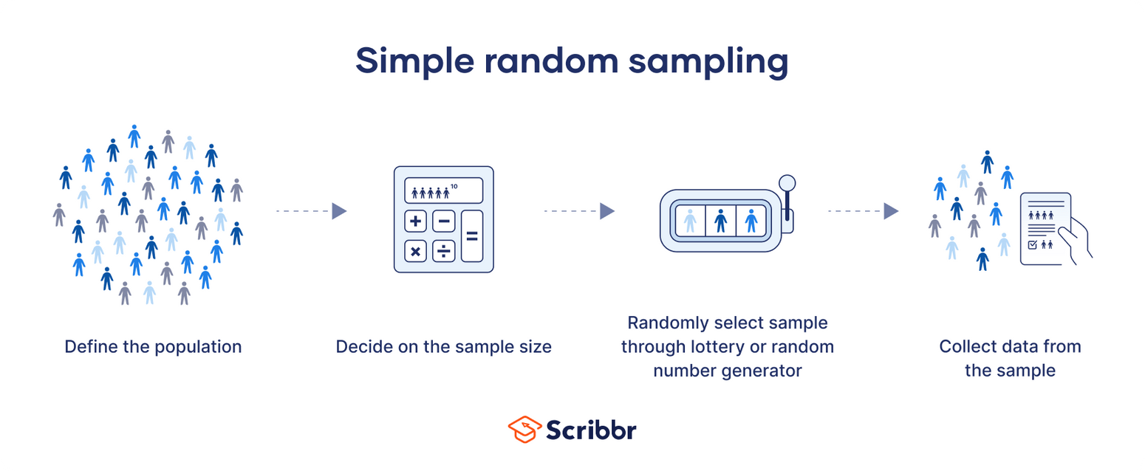
Probability or Random Sampling
  Simple Random Sampling
Sample:
From a population of 300 teachers, 169 are
selected randomly for the sample using draw lots
or other style of selection.
  In a simple random sample, every member of the population has an equal chance of being selected.

Slide 13
When to use Simple Random Sampling?
is used to make statistical inferences about a population.
It helps ensure high internal validity: randomization is the best method to reduce the
impact of potential confounding variables.
In addition, with a large enough sample size, a simple random sample has high
external validity: it represents the characteristics of the larger population.
Pre-requisites:
📌 You have a complete list of every member of the population.
📌 You can contact or access each member of the population if they are selected.
📌 You have the time and resources to collect data from the necessary sample size.
Simple random sampling works best if you have a lot of time and resources to conduct your study, or if you are studying a limited population that can easily be sampled.

Slide 14
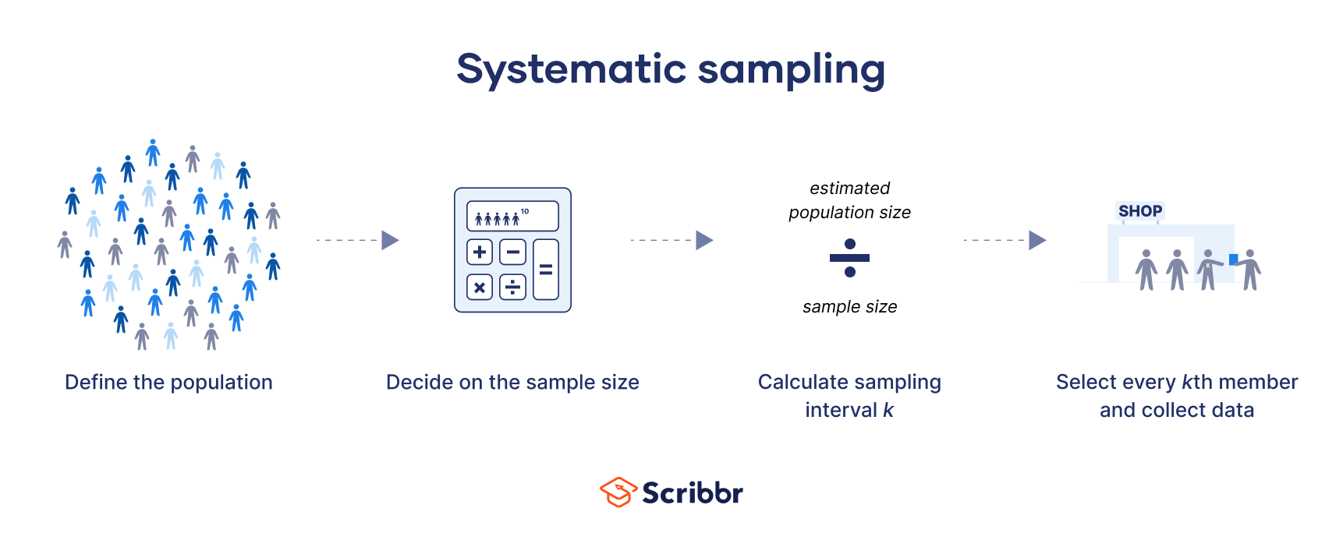
Systematic Sampling
2. Systematic Sampling
involves choosing your sample based on a regular interval, rather than a fully random selection. It can also be used when you don’t have a complete list of the population.
Is more simplified and versatile probability
sampling method where researchers select members of the population at a regular interval.
Involves choosing your sample based on a regular interval, rather than a fully random selection. It can also be used when you don’t have a complete list of the population.

Slide 15
Systematic Sampling
In systematic sampling, you have two choices for data collection:
📌 You can select your sample ahead of time from a list and then approach the selected subjects to collect
data, or;
📌 You can approach every kth member of your target population to ask them to participate in your study.
Research example:
You run a department store and are interested in how you can improve the store experience for your customers. To investigate this question, you ask an employee to stand by the store entrance and survey every 20th visitor who leaves, every day for a week.
Although you do not necessarily have a list of all your customers ahead of time, this method should still provide you with a representative sample of your customers since their order of exit is essentially random.

Slide 16
Systematic Sampling
Calculate sampling interval k:
When you know your target sample size, you can calculate your interval, k, by dividing your total estimated
population size by your sample size. This can be a rough estimate rather than an exact calculation.
Sample size and sampling interval:
Although you do not know exactly how many people will visit your store ahead of time, you can estimate the total population by using an average of the prior few weeks’ foot traffic.
You estimate that around 7500 people visit your store each week, and based on this estimate you calculate an ideal sample size of 366. Your sampling interval k thus equals 7500/366 = 20.49, which you round to 20.
From 7500, you can start with number 20 followed by number 40 so on and so forth...
Or just every 8th student in a class in the 12th grade for 10 sections.

Slide 17
Stratified Sampling
3. Stratified Sampling
a method of sampling that involves the division of a population into smaller
sub-groups known as Strata.
researchers divide a population into homogeneous subpopulations called strata e.g., race, gender identity, location, etc. Every member of the population studied should be in exactly one stratum.
Each stratum is then sampled using another probability sampling method, such as cluster sampling or simple random sampling, allowing researchers to estimate statistical measures for each sub-population.
Researchers rely on stratified sampling when a population’s characteristics are diverse and they want to ensure that every characteristic is properly represented in the sample. This helps with the generalizability and validity of the study, as well as avoiding research biases like undercoverage bias.

Slide 18
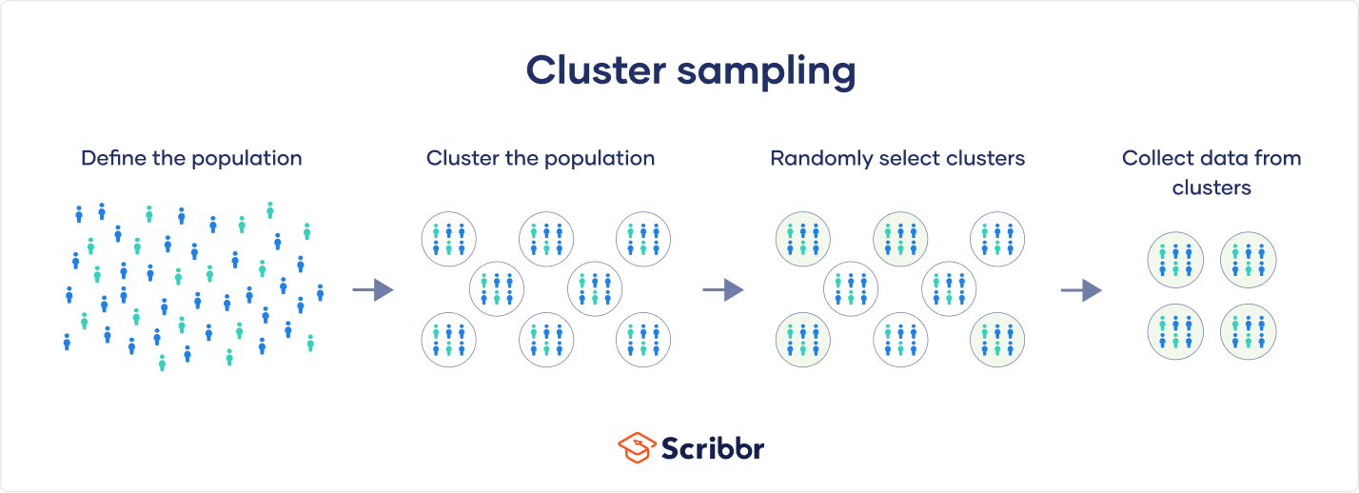
Cluster Sampling
3. Cluster Sampling
In cluster sampling, researchers divide a population into smaller groups known as clusters. They then randomly select among these clusters to form a sample.
Cluster sampling is a method of probability sampling that is often used to study large populations, particularly those that are widely geographically dispersed. Researchers usually use pre-existing units such as schools or cities as their clusters.

Slide 19
Simple - Cluster Sampling
How to cluster sample?
📌 Randomly select clusters to use as your sample
📌 Define your population
If each cluster is itself a mini-representation of the
larger population, randomly selecting and sampling
from the clusters allows you to imitate simple random sampling, which in turn supports the validity of your results.
You must first begin by clearly defining the population
you wish to study.
📌 Define your population
You must first begin by clearly defining the population
you wish to study. Should meet the following criteria:
  each cluster’s population should be as diverse as
possible.
  each cluster should have a similar distribution of the
population as a whole.
  taken together, the clusters should cover the entire population.
  There not be any overlap between clusters like, the same people or unit in more than one cluster.
📌 Collect data from the sample

Slide 20
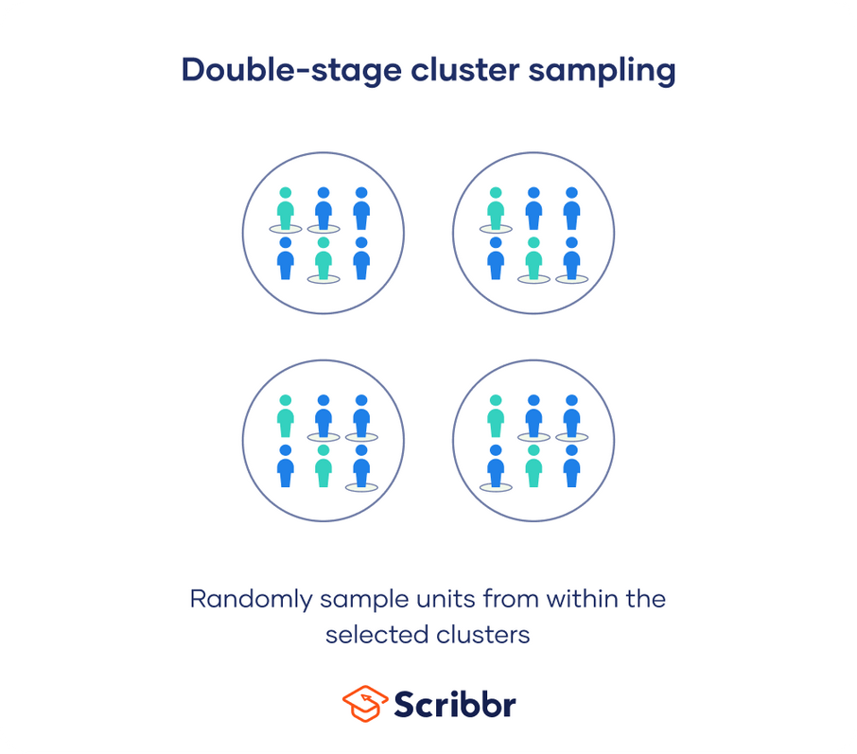
Multi-Stage Cluster Sampling
In multistage cluster sampling, rather than collect data from every single unit in the selected clusters, you randomly select individual units from within the cluster to use as your sample.
Example: Multistage sampling
Instead of collecting data from every seventh-grader in the selected schools, you narrow down your sample in two additional stages:
From each school, you randomly select a sample of seventh-grade classes.
From within those classes, you randomly select a sample of students.
2 Cities
7 Schools
3 sections/school x 30 students
35 Classes
Random students/class
7 x 3 x 30 = 670
Sample size = 245
245/35 classes = 7
7 random students/class

Slide 21
Cluster Sampling
Disadvantages
Advantages
📎 sampling is time- and cost-efficient, especially for samples that are widely geographically spread and would be difficult to properly sample otherwise.
🖇️ validity is less strong than with simple random sampling, particularly as you use more stages of clustering.
🖇️ If your clusters are not a good mini-representation of the population as a whole, then it is more difficult to rely upon your sample to provide valid results, and is very likely to be biased.
🖇️ Cluster sampling is much more complex to plan than other forms of sampling.
📎 because cluster sampling uses randomization, if the population is clustered properly, your study will have high external validity because your sample will reflect the characteristics of the larger population.

Slide 22
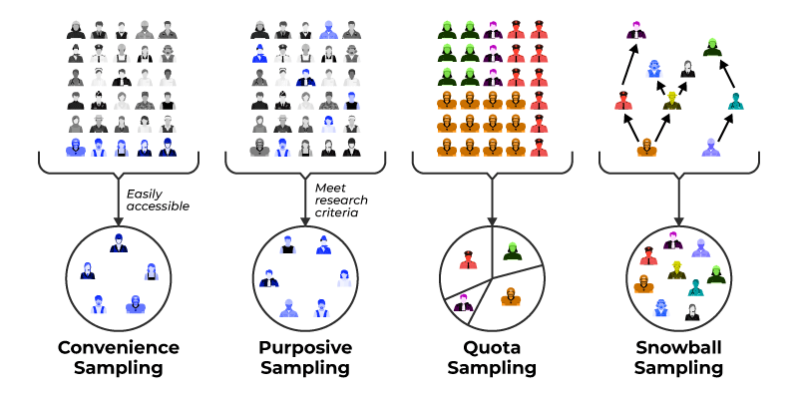
Non-Probablity Sampling Technique
Non-Probability
  This sample is one in which the probability of including population elements are unknown.
  Usually, not every element in the population has a chance of being selected.
  It is also quite common for the population to be the same as the sample, in which case there is no immediate need to generalize to a larger population.

Slide 23

Non-Probablity Sampling Technique
1.Convenience Sampling
  A convenience sample is a group of subjects because of availability.
  Convenience sampling is possibly the most effective shape of non-probability sampling.
  Researchers choose members based on their accessibility and proximity, making it convenient to collect information.
For example, surveying humans at a shopping center or a nearby park would be considered a convenience pattern.
🔖 this method is simple to implement, it frequently outcomes in a biased sample, as it may not as it should be represent the complete population.

Slide 24

Non-Probablity Sampling Technique
2. Purposive Sampling
  or judgmental sampling
  researchers handpick individuals who they consider are the maximum applicable or knowledgeable approximately the study topic. This method is frequently utilized in qualitative studies or whilst specialists’ evaluations are required.
However, it can introduce researcher bias and
may not be appropriate for generalization.
Example: In research on effective teaching it may be most informative to observe “expert” or “master” teachers rather than all teachers.
Example: Suppose a researcher is conducting a study on the performance of top-performing employee in a big company. Instead of choosing employee randomly, the researcher chooses to interview employee who have acquired a couple of awards and recognitions for their terrific work.

Slide 25
Non-Probablity Sampling Technique
Example:
A researcher wants to survey individuals about what smartphone brand they prefer to use. He/she considers a sample size of 500 respondents. Also, he/she is only interested in surveying ten states in the US. Here’s how the researcher can divide the population by quotas:
Gender: 250 males and 250 females
Age: 100 respondents each between the ages of 16-20, 21-30, 31-40, 41-50, and 51+
3. Quota Sampling
  is used when the researcher is unable to take a probability sample but still wants a sample that is representative of the entire population.
  entails dividing the population into subgroups or strata and then putting a quota for each subgroup.
  Different composite profiles of major groups in the population are identified, and then subjects are selected, non-randomly, to represent each group.
  A type of quota sampling that is common in educational research is conducted to represent geographic areas or types of communities, such as urban, rural, and suburban.

Slide 26

Non-Probablity Sampling Technique
3. Quota Sampling
Characteristics of quota sampling:
  Aims to get the best representation of respondents in the final sample.
  Quotas replicate the population of interest in a real sense.
  The estimates produced are more representative.
  The quality of quota samples vary.
  Saves research data collection time as the sample represents the population.
  Saves research costs if the quotas accurately represent the population.
  It monitors the number of types of individuals who take the survey.
  The researcher always divides the population into subgroups.
  The sample represents the entire population.
  Researchers use the sampling method to identify the traits of a specific group of people.

Slide 27
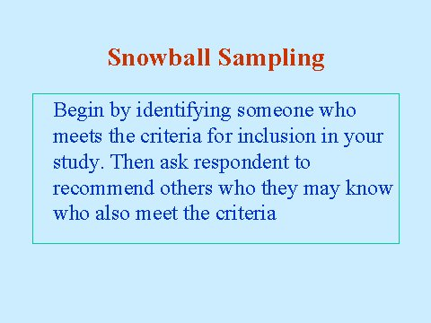
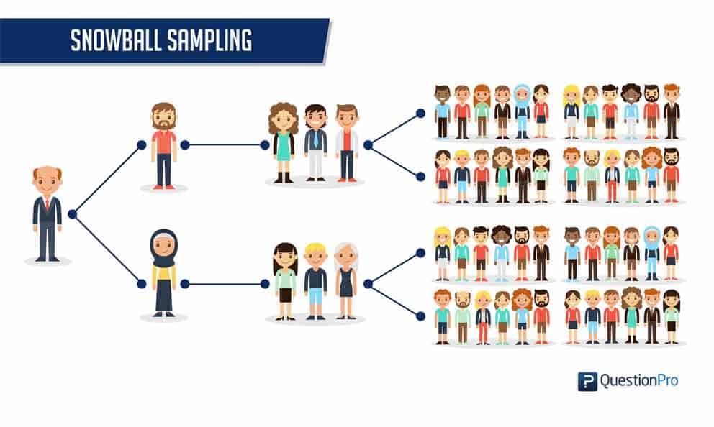
Non-Probablity Sampling Technique
4. Snowball Sampling
non-probability sampling technique in which the samples have rare traits. This is a sampling technique, in which existing subjects provide referrals to recruit samples required for a research study.

Slide 28

Non-Probablity Sampling Technique
Types of Snow Sampling:
Linear snowball sampling
This method forms a sample group with a single subject. They provide contact information for one other person who would be appropriate for the study. That person is invited to join and provide one referral themselves. This continues until enough people have been recruited for the study.
Exponential non-discriminative snowball sampling
As with linear snowball sampling, this method starts with a single participant. They provide contact information for multiple potential subjects who are invited to participate. These people are then asked to provide referrals to multiple other potential participants.
Exponential discriminative snowball sampling
This approach is a combination of the previous two. Each participant provides multiple referrals to people who may be interested in joining the study. Out of that group, one person is invited to participate based on the study’s unique requirements. This enables researchers to narrow down the participants based on the characteristics they’re looking for.
This type of snowball sampling takes the most time, but it allows researchers to make the most detailed choices about who participates in the study.

Slide 29
References:
  Bevans, R. (2023, June 22). Understanding Confidence Intervals | Easy Examples & Formulas. Retrieved July 10, 2024.
  Bhandari, P. (2023, June 21). Population vs. Sample | Definitions, Differences & Examples. Retrieved July 10, 2024,
  DhavalMakwana | Priti Engineer | AmishaDabhi | Hardik Chudasama "SamplingMethods in Research: A Review"Published inInternational Journalof Trend inScientific Researchand Development(ijtsrd), ISSN: 2456-6470, Volume-7 |Issue-3, June 2023,pp.762-768, URL:www.ijtsrd.com/papers/ijtsrd57470.pdf (4) (PDF) Sampling Methods in Research: A Review. Available from: https://www.researchgate.net/publication/371985656_Sampling_Methods_in_Research_A_Review [accessed Jul 11 2024].
  Dovetail Editorial Team. (2023, February 5). Snowball sampling: Explanation, examples, pros, and cons. https://dovetail.com/research/snowball-sampling/
  Martínez-Mesa, J., González-Chica, D. A., Duquia, R. P., Bonamigo, R. R., & Bastos, J. L. (2016). Sampling: how to select participants in my research study? Anais Brasileiros De Dermatologia/Anais Brasileiros De Dermatologia, 91(3), 326–330. https://doi.org/10.1590/abd1806-4841.20165254
  McCombes, S. (2023, June 22). Sampling Methods | Types, Techniques & Examples. Retrieved July 10, 2024,
  Nikolopoulou, K. (2023, June 22). What Is Snowball Sampling? | Definition & Examples. Retrieved July 10, 2024,
  Thomas, L. (2023, December 18). Simple Random Sampling | Definition, Steps & Examples. Retrieved July 10, 2024.

Slide 30


for listening

